Slide 1

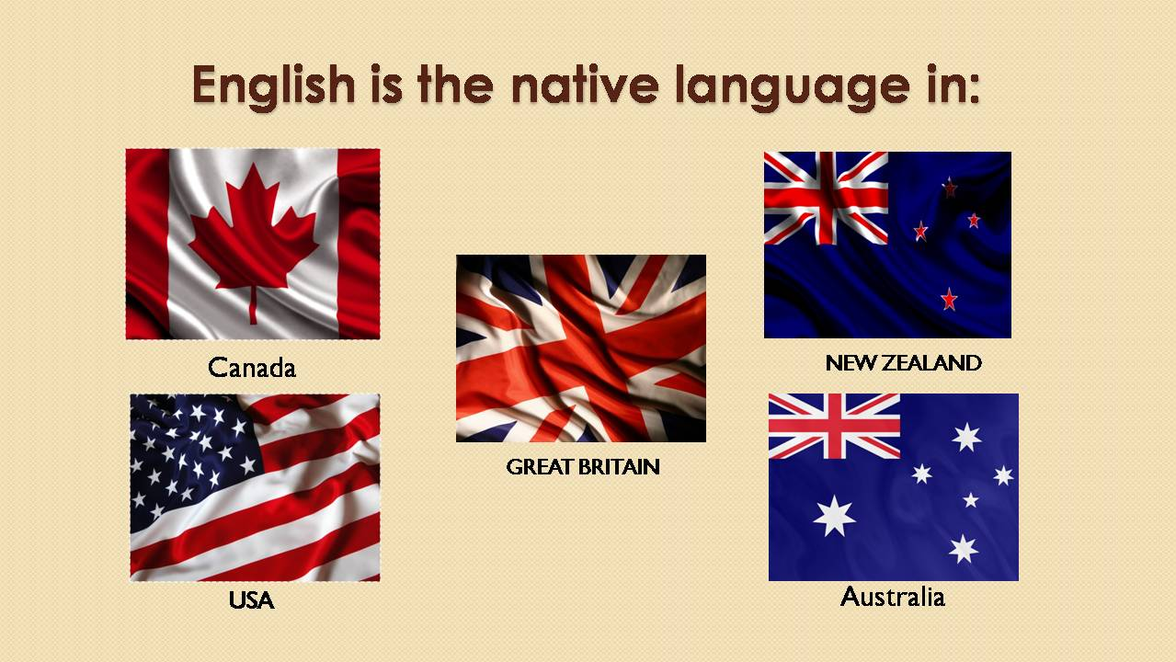
Jeopardy Game!

Slide 2
1 round
theme | questions
1. Countries. Their capitals and symbols | 10 | 20 | 30 | 50 | 70
2. Holidays | 10 | 20 | 30 | 50 | 70
3. Famous facts about English-Speaking countries | 10 | 20 | 30 | 50 | 70
4. Writers and characters | 10 | 20 | 30 | 50 | 70

Slide 3
1.
10 points.
Question: What is the nickname of the British flag?
Answer: Union Jack

Slide 4
1.
20 points.
Question: What is the American flag called?
Answer : The Stars and Stripes

Slide 5
1.
30 points.
Question: What is the biggest and the oldest city in Australia?
Answer : Sydney

Slide 6
1.
50 points.
Question: What country has the nickname the Lady of the Snows?
Answer : Canada

Slide 7
1.
70 points.
Question: Match the country and the capital
Anwser: The UK – London; Scotland – Edinburgh; The USA – Washington; Australia – Canberra; New Zealand – Wellington; Northern Ireland – Belfast; Wales - Cardiff
The UK | Washington
Scotland | London
The USA | Edinburgh
Australia | Wellington
New Zealand | Belfast
Northern Ireland | Cardiff
Wales | Canberra

Slide 8
2.
10 points.
Question: What are the traditional symbols of Christmas?
Answer : Santa Claus, Snowmen, a Christmas tree

Slide 9
2.
20 points.
Question : What is Jack-o’-lantern made out of?
Answer Pumpkins

Slide 10
2.
30 points.
Question: When is Fool Day celebrated and what for?
Answer : On the 1st of May, to make jokes

Slide 11
2.
50 points.
Question: What is the most important celebration in the USA?
Answer : The Independence Day

Slide 12
2.
70 points.
Question: When do the Englishmen celebrate Guy Fawkes’ Night?
Answer : On 5th November

Slide 13
3.
10 points.
Question: What is the name of the most famous clock in Great Britain?
Answer : Big Ben

Slide 14
3.
20 points.
Question: What are the oldest English universities?
Answer : Cambridge, Oxford

Slide 15
3.
30 points.
Question: Where is Hollywood situated?
Answer : in California, the USA

Slide 16
3.
50 points.
Question: What city is called “Big Apple”?
Answer : New York

Slide 17
3.
70 points.
Question: What is the financial part of London?
Answer : The City of London

Slide 18
4.
10 points.
Question: He wrote a famous book for children Alice’s Adventures in Wonderland?
Answer : Lewis Carroll

Slide 19
4.
20 points
Question: The home of the first great detective Sherlock Holmes?
Answer : Baker Street

Slide 20
4.
30 points.
Question: What is the title of Mark Twain’s most popular book for children?
Answer : The Adventures of Tom Sawyer

Slide 21
4.
50 points.
Question : Who is the National Hero of Great Britain, the defender of the poor people?
Answer : Robin Hood

Slide 22
4.
70 points.
Question : What is the real name of Samuel Langhorne Clemens?
Ответ: Mark Twain

Slide 23
2 round
theme | questions
1. Proverbs | 20 | 40 | 60 | 80 | 100
2. Agree or disagree | 20 | 40 | 60 | 80 | 100
3. Countries | 20 | 40 | 60 | 80 | 100
4. Creative work | 20 | 40 | 60 | 80 | 100

Slide 24
1.
20 points.
Вопрос: Match the proverb with the translation
Ответ:

Slide 25
1.
40 баллов.
Вопрос: Agree or disagree with me
Ответ:

Slide 26
1.
60 баллов.
Вопрос:
Ответ:

Slide 27
1.
80 баллов.
Вопрос:
Ответ:

Slide 28
1.
100 points.
Question: Match the proverb with the translation
Answer :

Slide 29
2.
20 баллов.
Вопрос:
Ответ:

Slide 30
2.
40 баллов.
Вопрос:
Ответ:

Slide 31
2.
60 баллов.
Вопрос:
Ответ:

Slide 32
2.
80 баллов.
Вопрос:
Ответ:

Slide 33
2.
100 points.
Question : Agree or disagree with me
Answer :

Slide 34
3.
20 баллов.
Вопрос:
Ответ:

Slide 35
3.
40 баллов.
Вопрос:
Ответ:

Slide 36
3.
60 баллов.
Вопрос:
Ответ:

Slide 37
3.
80 баллов.
Вопрос:
Ответ:

Slide 38
3.
100 points
Question : Match the flag with the symbol and name the country
Answer :

Slide 39
4.
20 баллов.
Вопрос:
Ответ:

Slide 40
4.
40 баллов.
Вопрос:
Ответ:

Slide 41
4.
60 баллов.
Вопрос:
Ответ:

Slide 42
4.
80 баллов.
Вопрос:
Ответ:

Slide 43
4.
100 points.
Question: Draw a picture
Answer :

Slide 44
3 раунд
Тема раунда:
«…»

Slide 45
Вопрос
текст вопроса
ответ

Slide 46

Подведение итогов викторины

Slide 47
Использованные интернет-ресурсы:
Картинка на титульном слайде:
http://images.yandex.ru/yandsearch?text=%D1%81%D0%B2%D0%BE%D1%8F%20%D0%B8%D0%B3%D1%80%D0%B0&noreask=1&pos=1&rpt=simage&lr=9&img_url=http%3A%2F%2Fcs4463.userapi.com%2Fg16000362%2Fa_4b2c76ec.jpg
кубок:
http://images.yandex.ru/yandsearch?p=5&text=%D0%BF%D0%BE%D0%B4%D0%B2%D0%B5%D0%B4%D0%B5%D0%BD%D0%B8%D0%B5%20%D0%B8%D1%82%D0%BE%D0%B3%D0%BE%D0%B2%20%D0%B8%D0%B3%D1%80%D1%8B%20%D0%BA%D0%B0%D1%80%D1%82%D0%B8%D0%BD%D0%BA%D0%B0&noreask=1&pos=158&rpt=simage&lr=9&img_url=http%3A%2F%2Flestroismousquetons.free.fr%2Fimages%2Ftrophy.png
Автор шаблона игры: Вовденко О.Л., учитель математики
МБОУ СОШ № 61 им. М.И. Неделина г. Липецк

